Slide 1
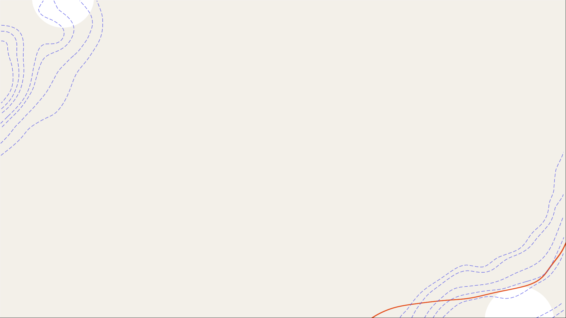
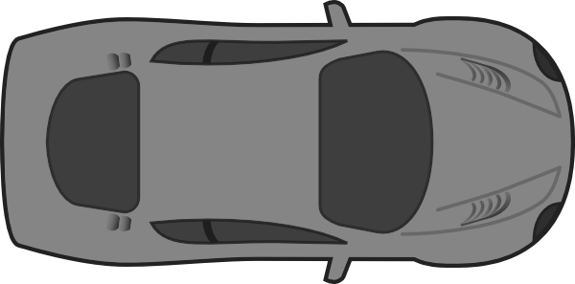


LOC
A map made for frequent drivers
Team 092: Sweni, Sanjana, and Caitlin

Slide 2
AGENDA
1
2
3
4
5
Dark
Mode
Single Destination Algorithms
Multiple Destination
Algorithms
Pitch
Find/Help
Button

Slide 3

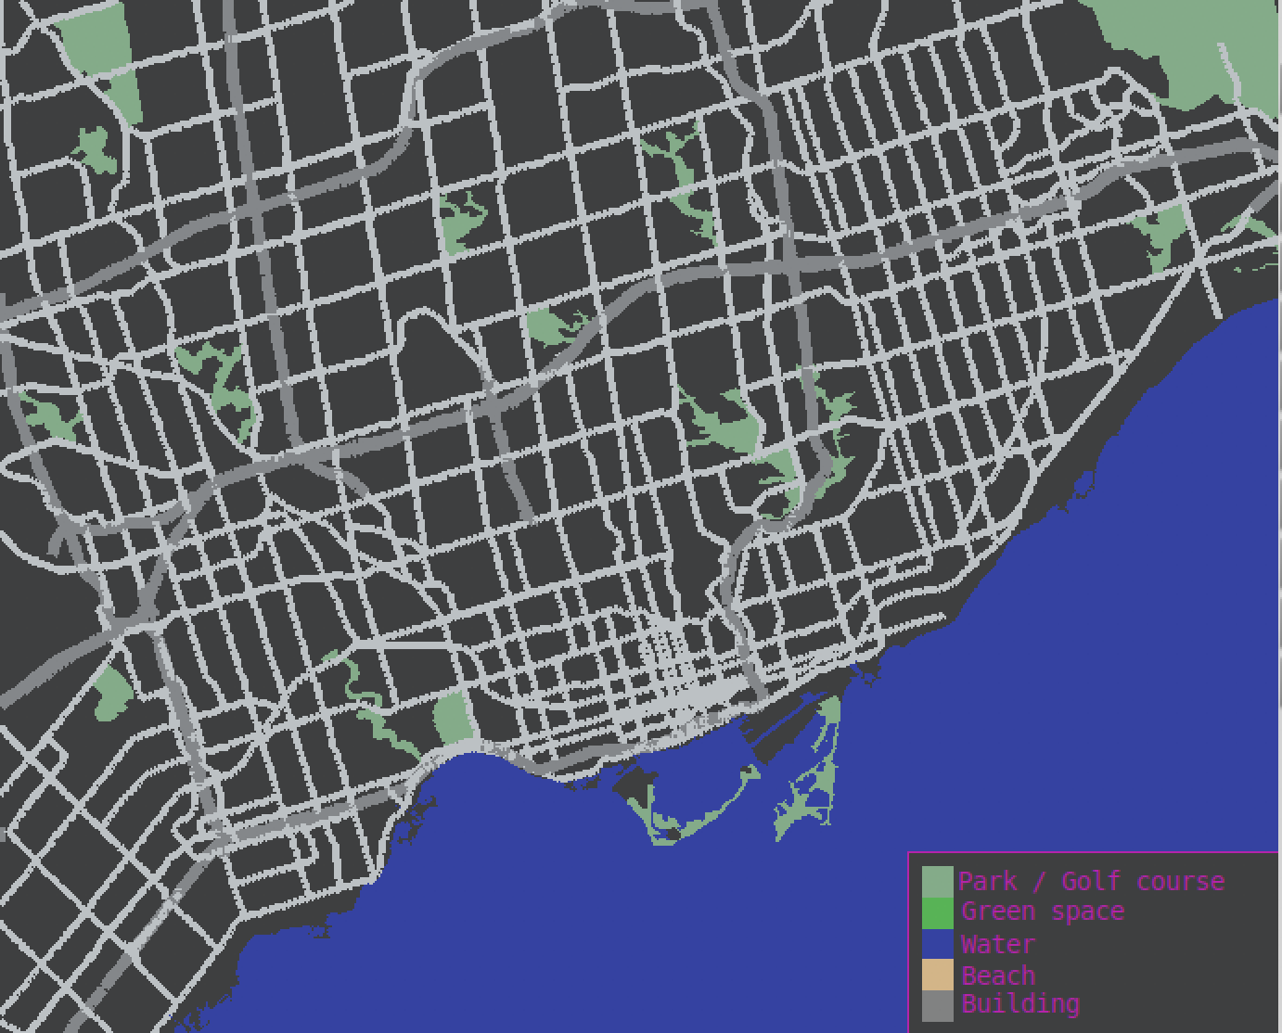
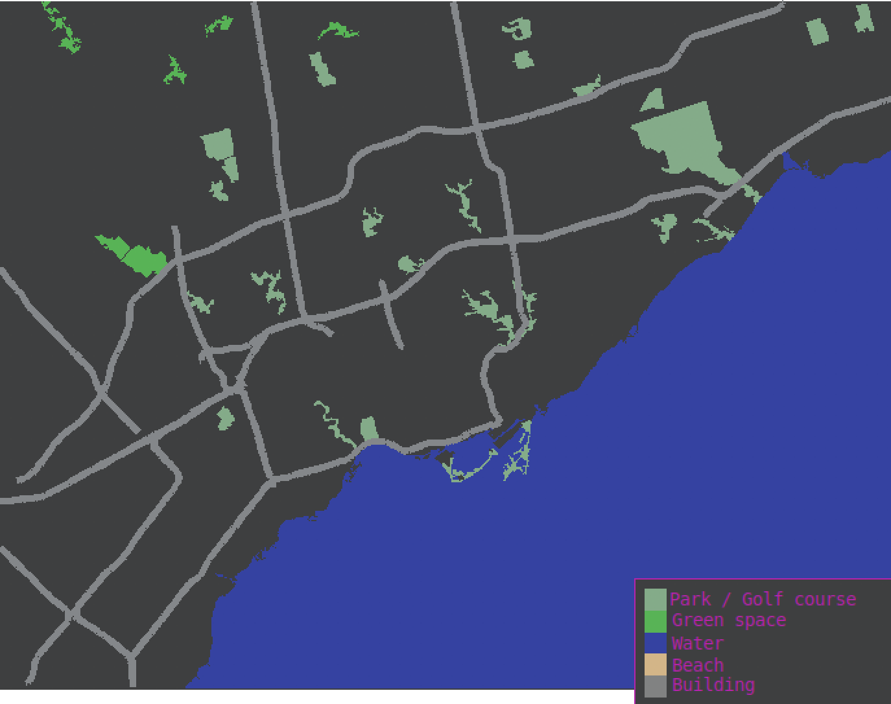
Dark Mode
Great aesthetics = 100% extra cool
Increase in popularity since 2019 [1]
Color contrast and theme developed using shades of grey [2]
ZOOMED OUT
ZOOMED IN

Slide 4
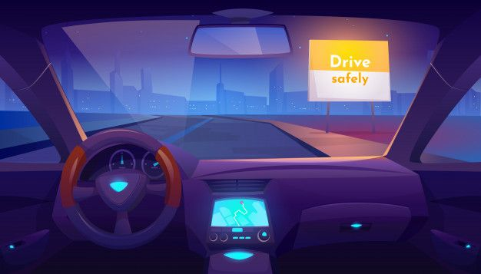
Too much glare
Too bright

Slide 5
Easier on eyes
Less glare

Slide 6



Benefits For Drivers
Less distracting could lead to lower accidents
59% Americans report digital eye strain [3]
Helps with eye fatigue [4]
Can be used in low-light settings increasing usability

Slide 7
AGENDA
1
2
3
4
5
Dark
Mode
Single Destination Algorithms
Multiple Destination
Algorithms
Pitch
Find/Help
Button

Slide 8



The FIND Button
Search for:
Intersections
Buildings
Closest POIs
“Each feature added gives the customer one more reason to choose the product” [5]
Streets

Slide 9
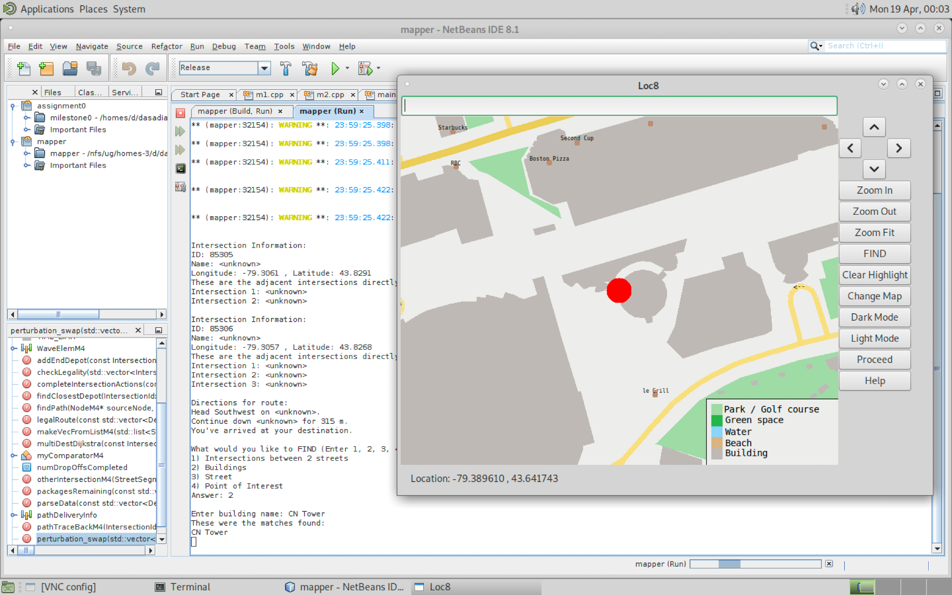
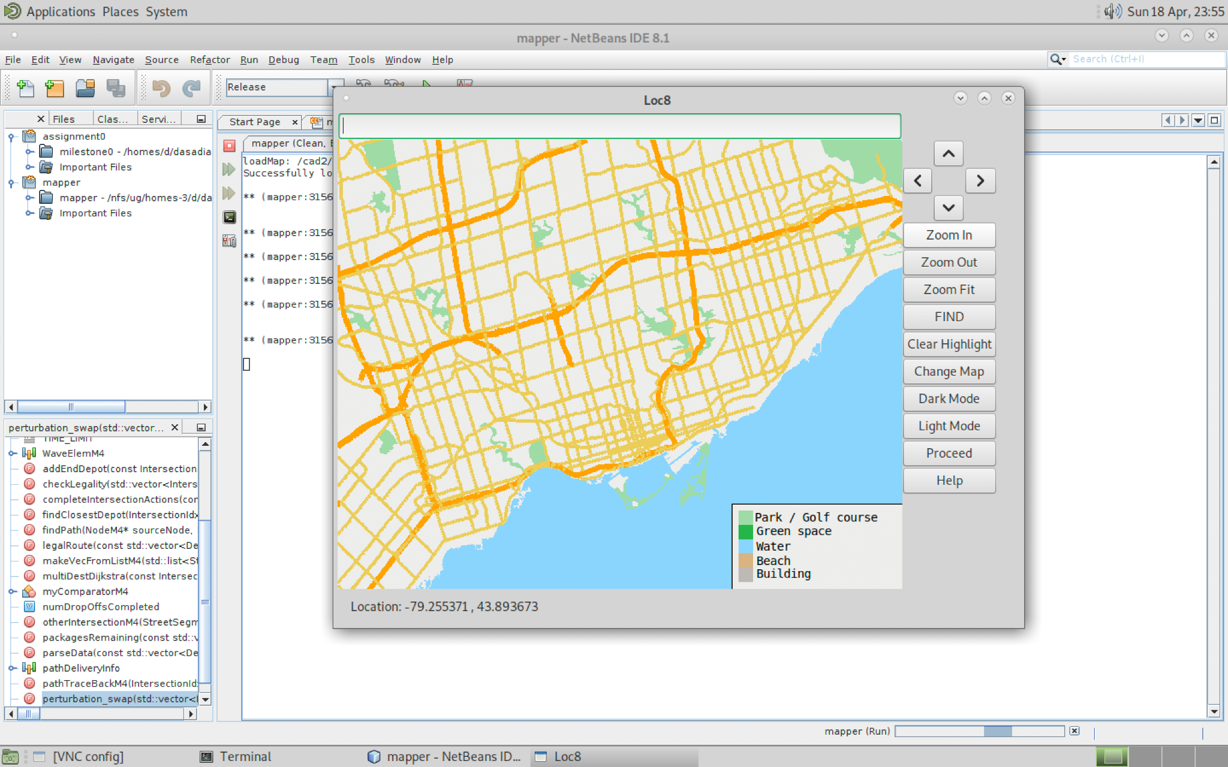
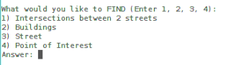
Using the FIND Button

Slide 10
The Help Button

Slide 11
AGENDA
1
2
3
4
5
Dark
Mode
Single Destination Algorithms
Multiple Destination
Algorithms
Pitch
Find/Help
Button

Slide 12






How to get to the movies?
Point B
Point A

Slide 13
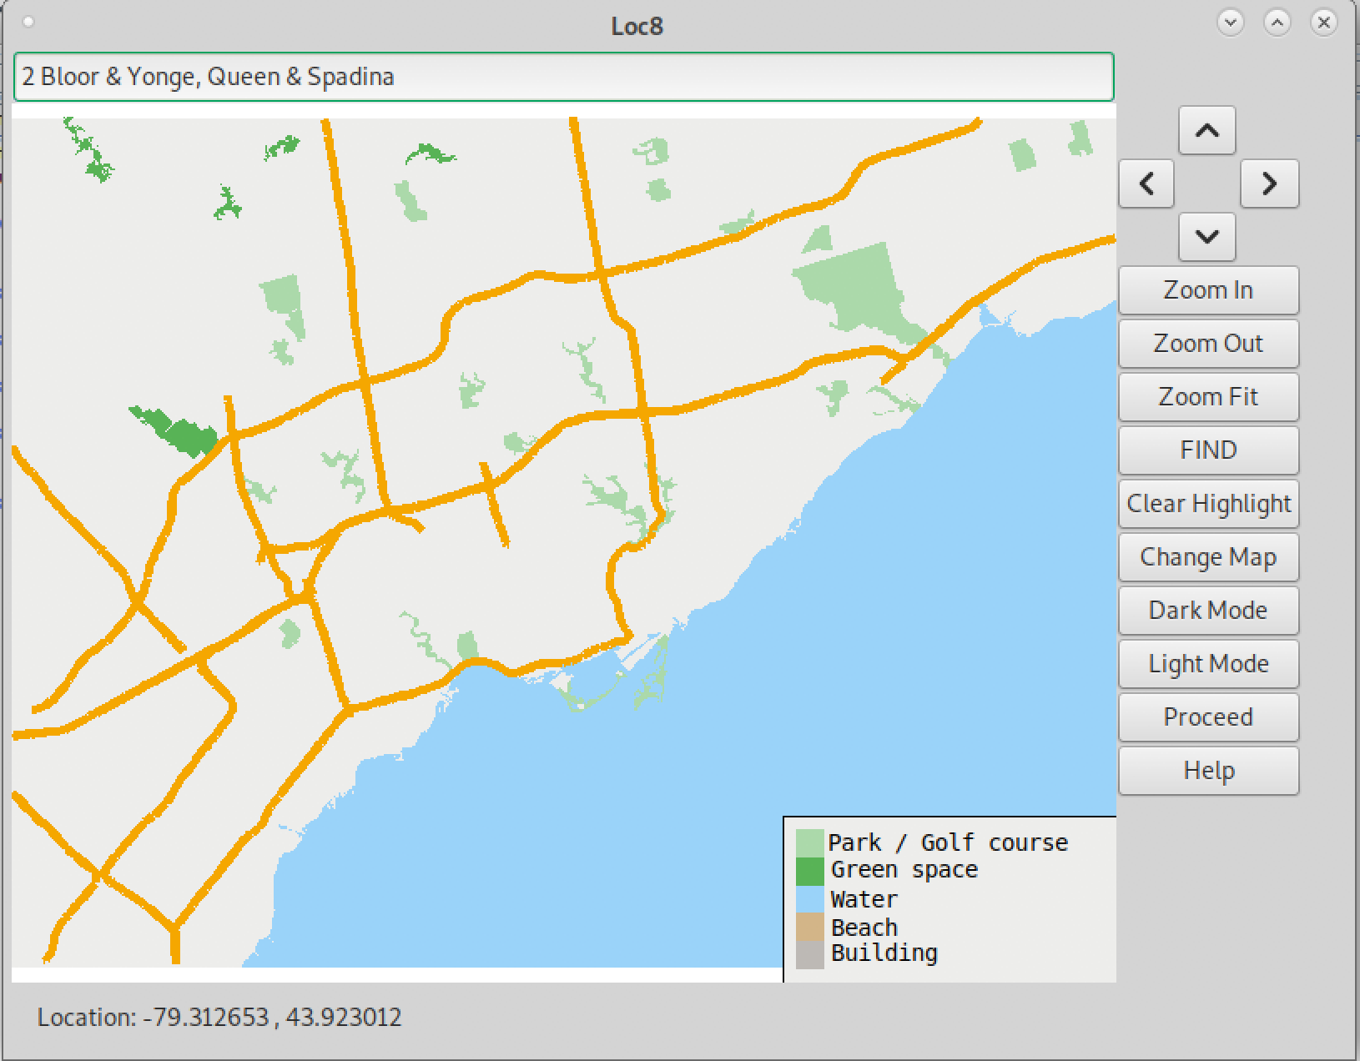
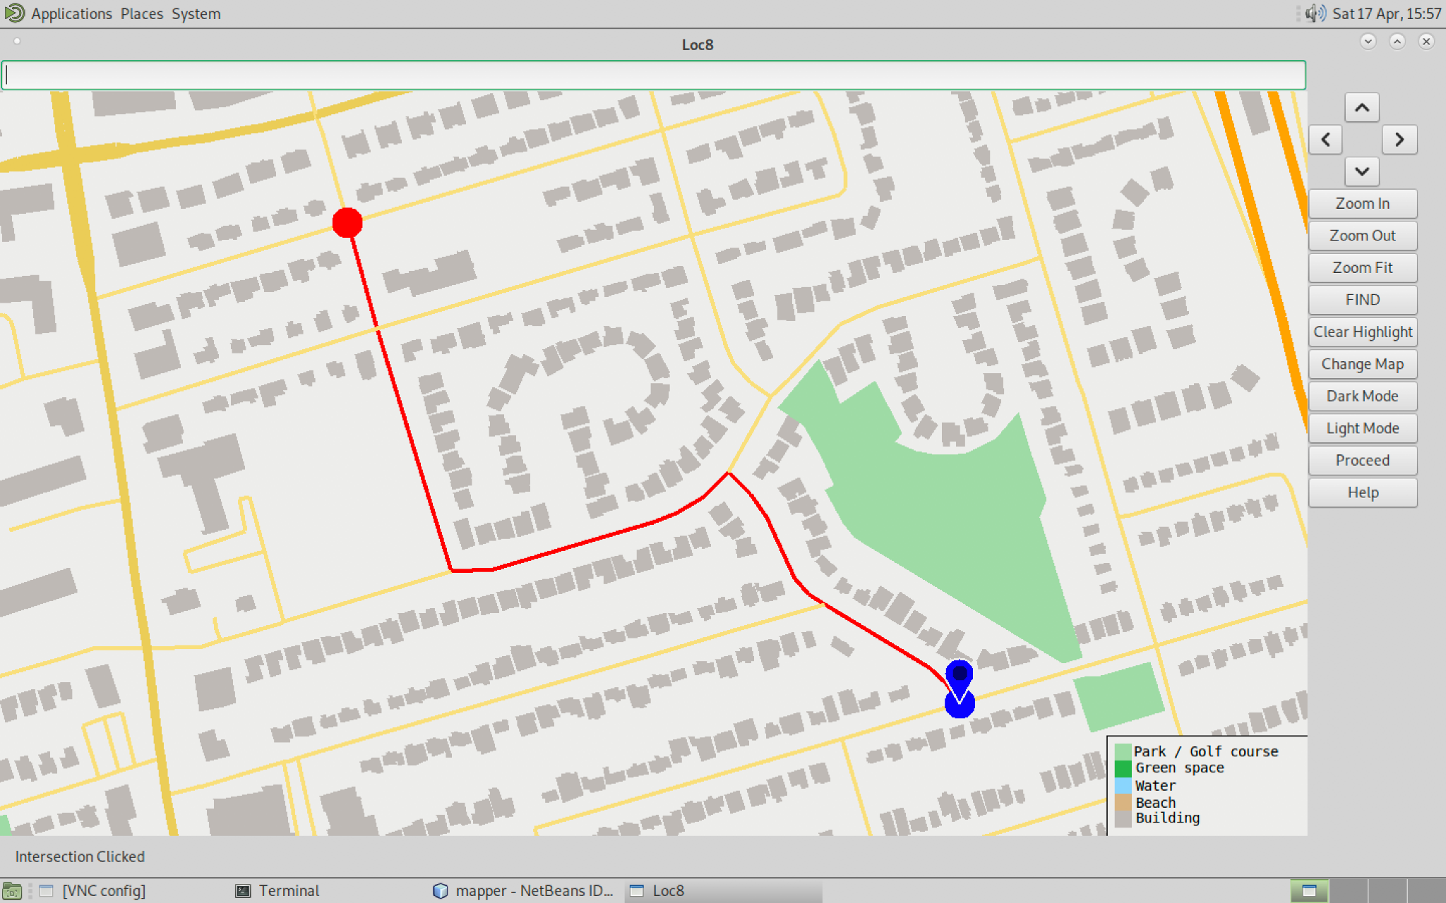
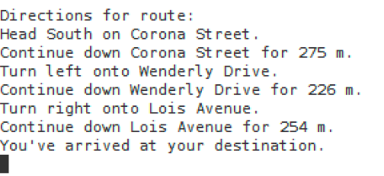
How to get to the movies?
Type in 2 intersections
Path Highlighted
Directions Outputted
Point A

Slide 14
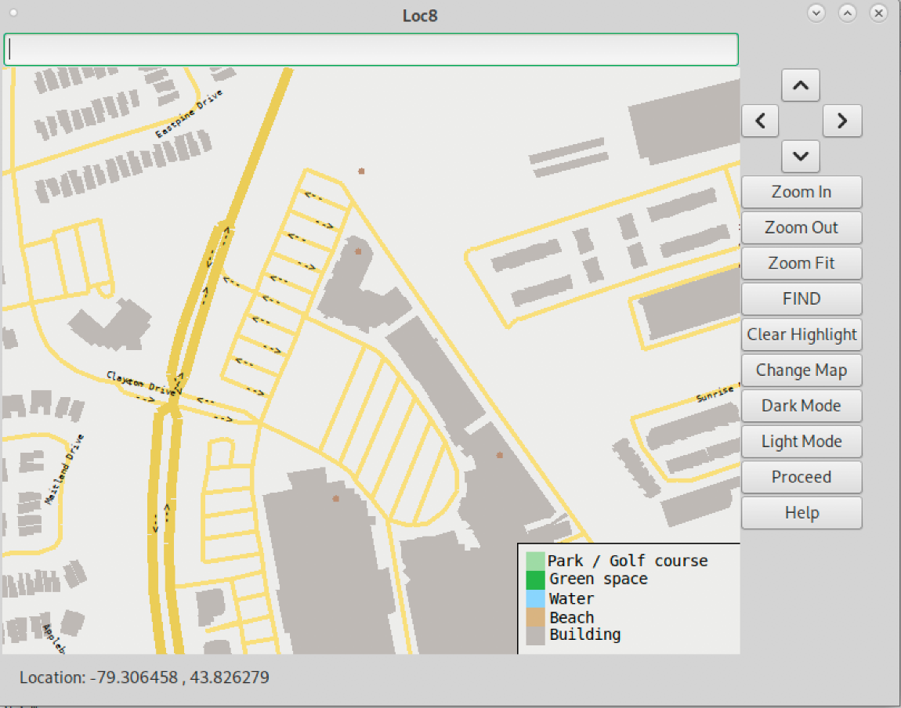
Dijkstra’s Algorithm
Expand outwards based on travel time
Stop expansion once the destination is found

Slide 15
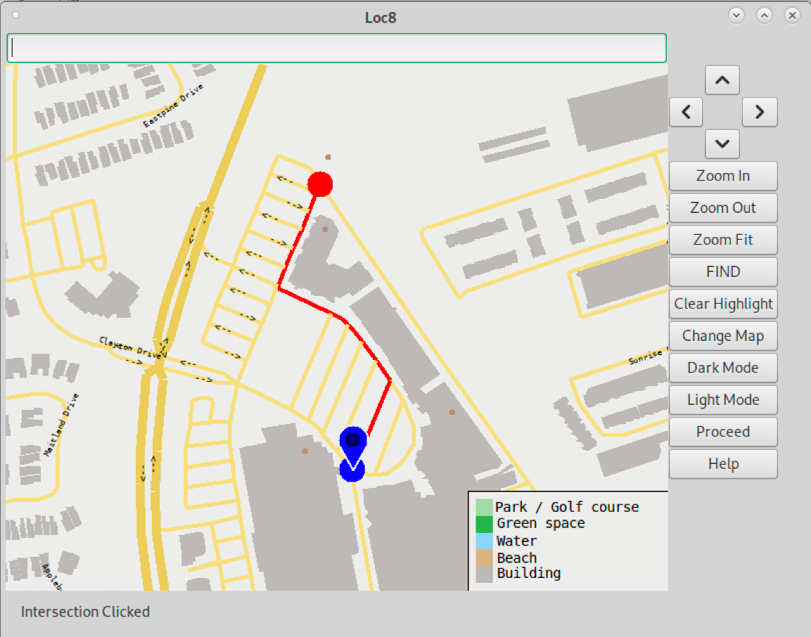
Dijkstra’s Algorithm
Expand outwards based on travel time
Stop expansion once the destination is found

Slide 16

Is Dijkstra’s Algorithm Fast Enough?

Slide 17
A* Algorithm
Improved Dijkstra’s
Chooses next expansion based on estimated travel time

Slide 18
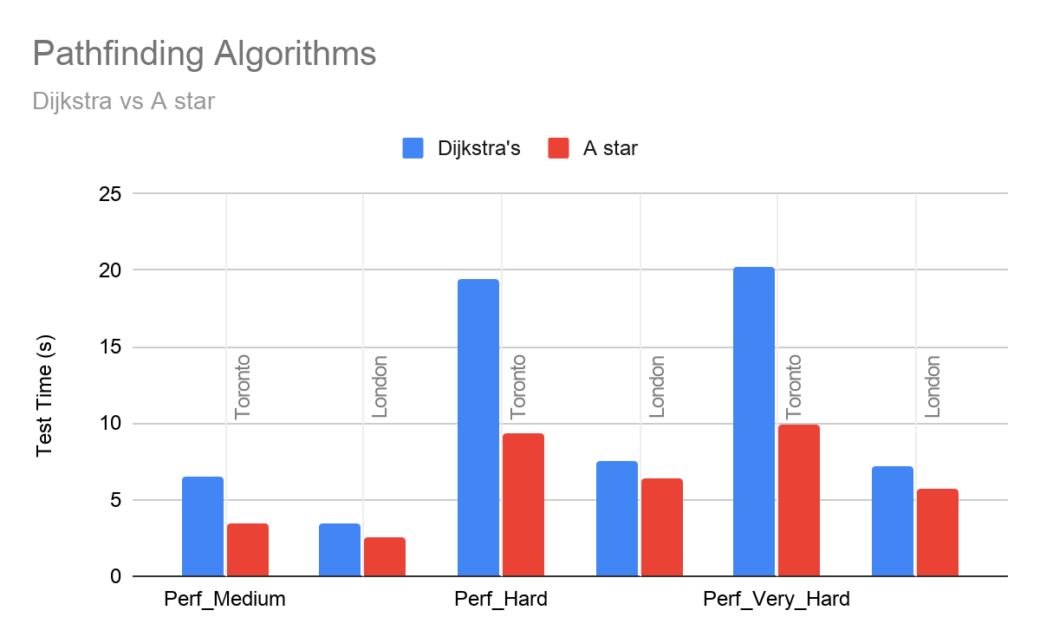
A* is Faster than Dijkstra’s
Perf_Medium
Perf_Hard
Perf_Very_Hard

Slide 19
AGENDA
1
2
3
4
5
Dark
Mode
Single Destination Algorithms
Multiple Destination
Algorithms
Pitch
Find/Help
Button

Slide 20



How to get to the movies? (part 2)
John’s House
Ashley’s House
Emily’s House
Sandra’s House

Slide 21
A* Dijkstra’s
More focused search toward destination
Searching in all directions evenly

Slide 22
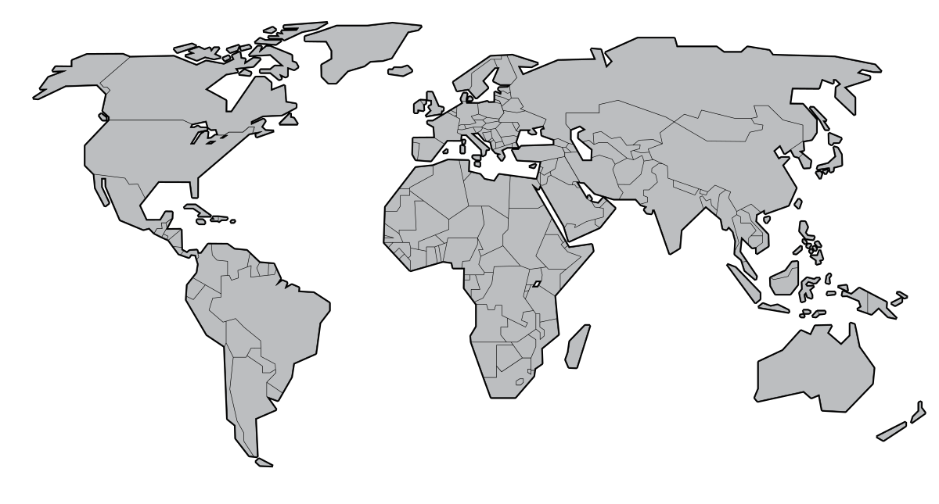
Very Expensive and Inefficient

Slide 23
Less Expensive and More Efficient

Slide 24
Implementation of Multi-Destination Dijkstra’s
Multiple calls made to path traceback and compute travel time
Store results returned by function into global 2D map
Allows for O(1) access to this information

Slide 25
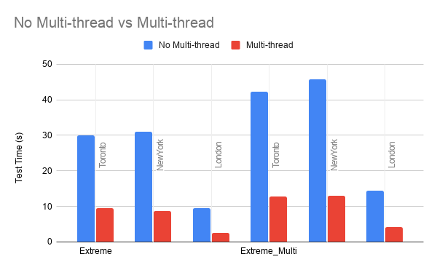
Multithreading = More Time!
Multithreading made our computations almost 4x faster!
Fast computation indicates good responsiveness
Gives us more time to perform perturbation and improve Quality of Results
Notes:
Hello

Slide 26

Swap Perturbation
Check if swap makes travel time shorter
Check if swap is legal
Keep track of time and keep swapping

Slide 27
AGENDA
1
2
3
4
5
Dark
Mode
Single Destination Algorithms
Multiple Destination Algorithms
Pitch
Find/Help
Button

Slide 28
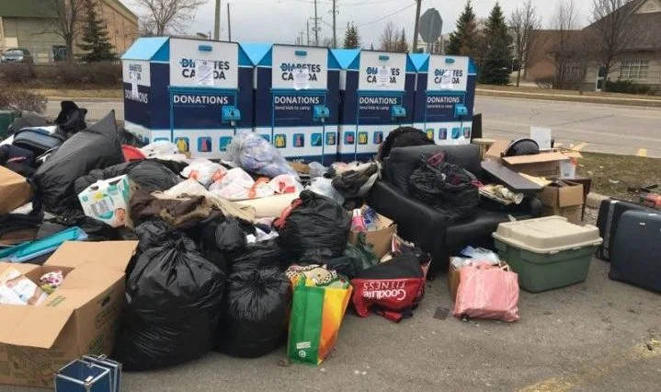
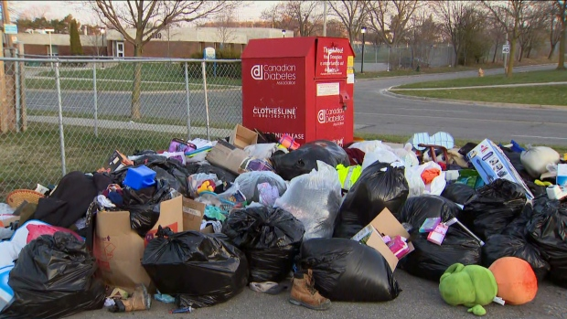
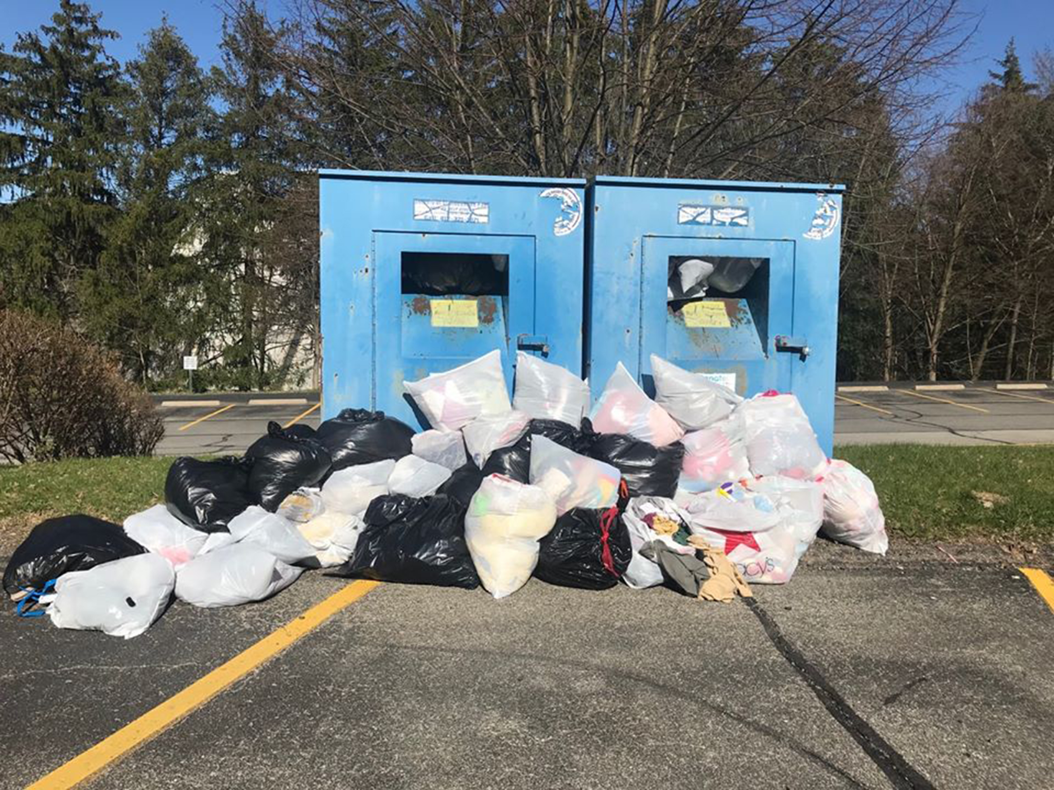
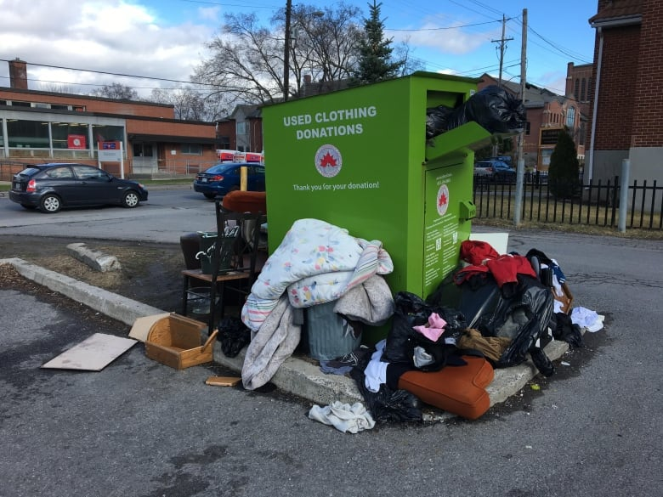
Donating clothes is inconvenient

Slide 29
DON
using
LOC
A GIS that makes clothing donation simple

Slide 30
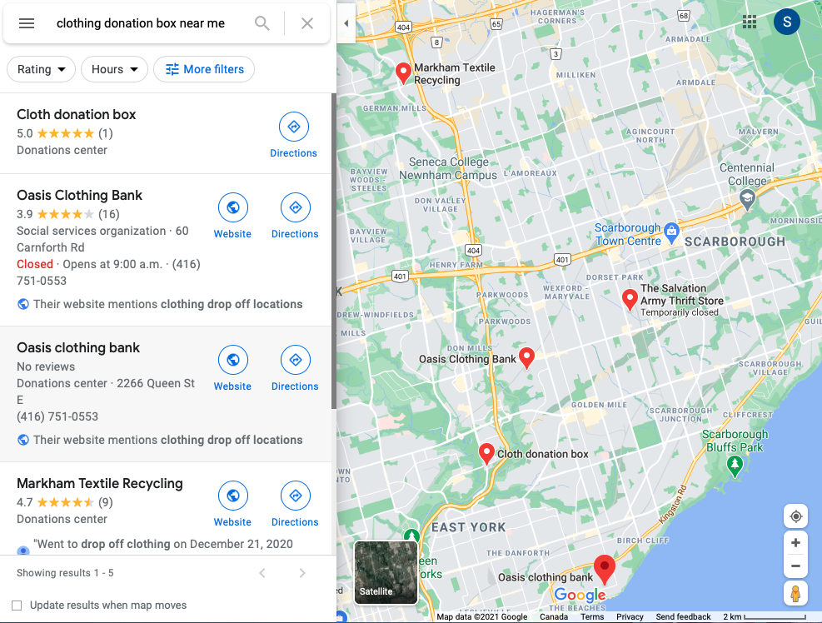
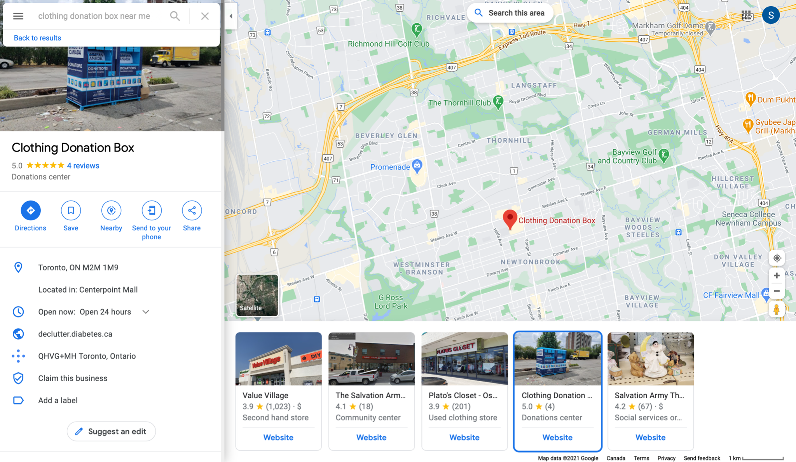

What's already out there?

Slide 31


What are we doing?
A* Algorithm to find closest donation box
Multi destination Dijkstra to find multiple boxes locations
Use open data sources and libCurl API library to access information
Attach sensors in box which can update if box is full or not

Slide 32
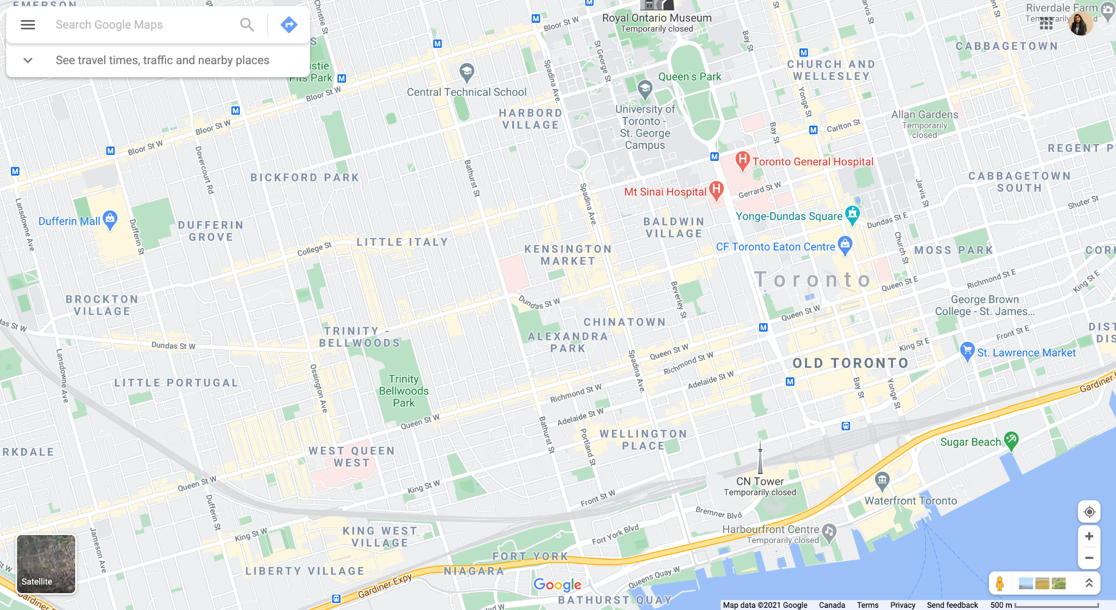
Prototype
Clothing donation box near me
Search bar
User location
Box location

Slide 33

Prototype
Clothing donation box near me
Charity:
Diabetes Canada
Capacity:
Full
FIND ROUTE

Slide 34
Prototype
Clothing donation box near me
Charity:
Diabetes Canada
Capacity:
Empty
FIND ROUTE

Slide 35
LOC
A map for frequent drivers
Questions?

Slide 36
References
Taylor, C. (2019, December 06). Why 2019 was the year of dark mode. Retrieved March 26, 2021, from
https://mashable.com/article/dark-mode-apps-instagram-google-chrome-apple-ios13/
A. Kulkarni, “Dark Mode UI: the definitive guide,” Medium, 29-Dec-2020. [Online]. Available:
https://uxdesign.cc/dark-mode-ui-design-the-definitive-guide-part-1-color-53dcfaea5129. [Accessed: 26-Mar-2021].
Q. Fottrell, “People spend most of their waking hours staring at screens,” MarketWatch, 04-Aug-2018. [Online]. Available:
https://www.marketwatch.com/story/people-are-spending-most-of-their-waking-hours-staring-at-screens-2018-08-01. [Accessed: 26-Mar-2021].
M. Heid, “Can Computers Really Cause Eye Problems,” Time, 03-Sep-2014. [Online]. Available:
https://time.com/3257927/you-asked-can-computers-ruin-eyes/. [Accessed: 26-Mar-2021].
R. W. Hamilton, R. T. Rust, and C. S. Dev, “Which Features Increase Customer Retention?,” MIT Sloan Management Review, 30-Nov-2016.
[Online]. Available: https://sloanreview.mit.edu/article/which-features-increase-customer-retention/. [Accessed: 24-Mar-2021].
Brown, R. (n.d.). “The environmental crisis caused by TEXTILE WASTE”. [Online]. Available:
https://www.roadrunnerwm.com/blog/textile-waste-environmental-crisis [Accessed: 20-Apr-2021]

